Slide 1
Mr C & Mrs R
Financial Strategy Update
October 2014
ABC is authorised and regulated by the Financial Conduct Authority

Slide 2
Contents
Why you plan
Your objectives
Where are you now?
Cash-flow projections
What is your risk profile?
What is the plan? Our Recommendations
Our Investment Process – looking after your money
Fees
The Results and Carry Forward

Slide 3
Why you plan
As with any investment made in life — a family, a home, a university education — the best results are achieved by carefully constructing a plan and then following that plan consistently over time, making the necessary adjustment to unforeseen circumstances. The plan is backed up with a sound investment strategy.
This document revisits your plan, considering your goals, time horizons, your tolerance for risk and the relevant tax issues .

Slide 4
Your objectives
Income: You wish to maintain the current level of you lifestyle now and into the future;
Event: You would like to sell the business and your Buy-to-Let property as soon as possible;
Succession: You would like to pass some assets on to your heirs but this is not essential – in any event you want to pay as little IHT as possible;
Tax: You want to pay as little tax as possible;
Investments: You want to maintain the real value of your investments, but not at the expense of your lifestyle, as long as you don’t run out of money!

Slide 5
Where Are You Now
Your Assets in October 2014 ?
Cash
Total: £161,112
Cash
Building Society A/C’s
£91,937
Cash ISAs
£2,624
National Savings
£60,000
ShareBuilder /Savings
Plans
£6,551
Property Assets
Total: £1,525,000
Main Home
Value: £850,000
Debt: £0
Other property
Value: £675,000
Debt: £0
Investments
Total: £2,775,000
Pension Funds
£275,000
Company
Shareholdings
Value £2,500,000
Total Net Worth:
£4,461,112

Slide 6
Your current ins & outs in October 2014
Income:
Income Source | Chris | Rose | Total
Employment income (net) | £48,000 | £48,000 | £98,000
Property income*(net) | £14,500 | £14,500 | £29,000
Total net income | £62,500 | £62,500 | £125,000
Outgoings:
* For simplicity Income from spreadsheet divided by two.
Outgoings based on your expenditure sheet.
£79,468 pa
Surplus / Defici:
Based on the above figures you currently have surplus income of £45,932 p/a.

Slide 7
Assumptions in cash-flow models
Assumption Area | Data Used & Explanatory Notes
Savings at start | £436,112 Cash, Cash ISAs, Pensions & National Savings.(Excludes all property unless stated).
Potential Expected Lump Sums | Sale of Company 2015 £2,500,000 Sale of Buy To Let Portfolio £675,000
Inflation Rate | 2.0% pa.
Potential Investment Return | 1). 4% net pa Moderately Cautious Investor. 2). 5% net pa Balanced Investor.
Income | Income, includes earned income and property income: £125,400 net of tax pa. (State Pension inflation proofed).
Outgoings | £79,468 pa increasing by inflation*This is increased to £125,000 pa post retirement as per your forecast.
Client Age | Chris Current age 47 Rose 48. (47 yrs. used)
Life expectancy | Run until age 99 to demonstrate longevity of assets.
7
Notes:
7

Slide 8
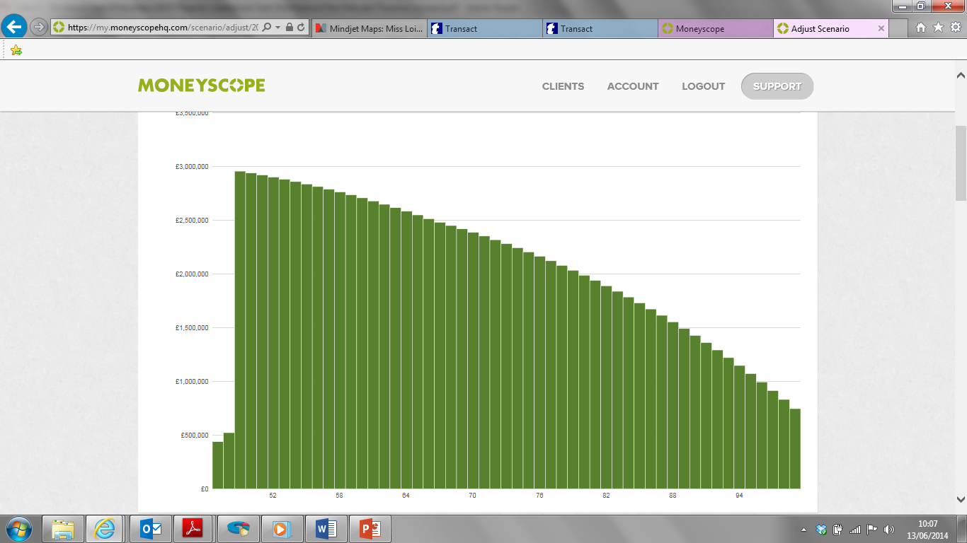
Cash-flow projection 1
Scenario 1: Sale of Company 2015, Buy To Let’s Maintained and a 5% Assumed Net Growth Rate.
Excludes Residential Property
£750,000
8

Slide 9
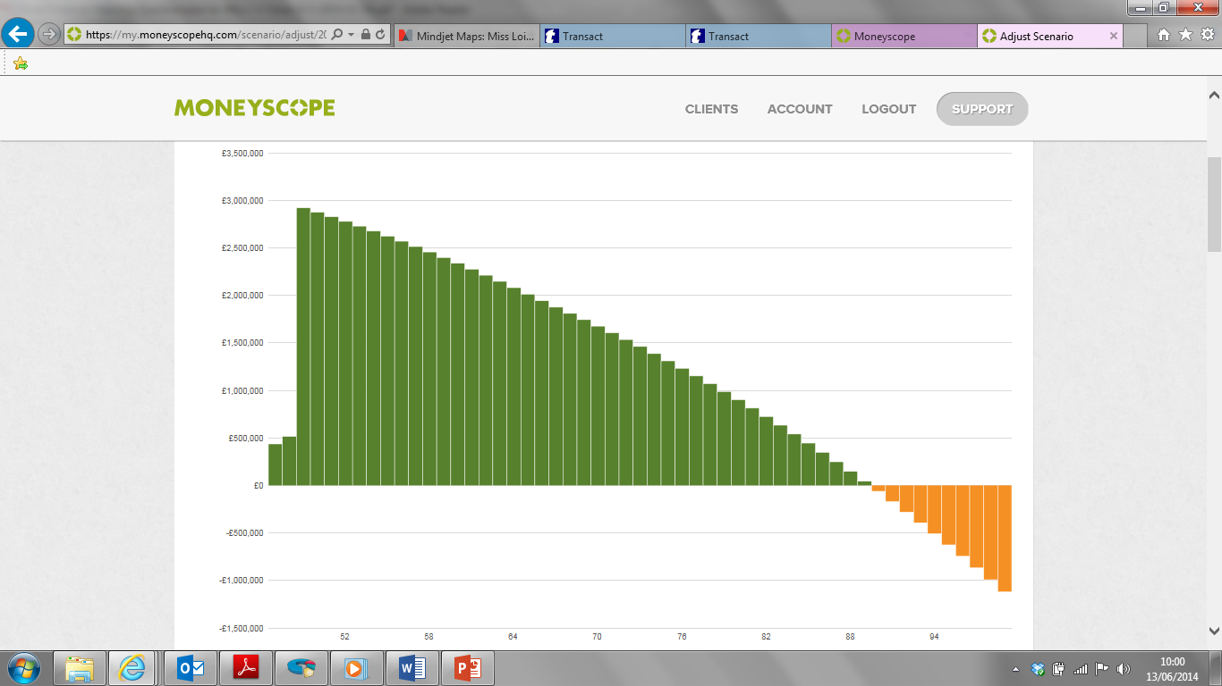
Cash-flow projection 2
Scenario 2: Sale of Company 2015, Buy To Let’s Maintained and a 4% Assumed Net Growth Rate.
Excludes Residential Property
- £1,025,000
9

Slide 10
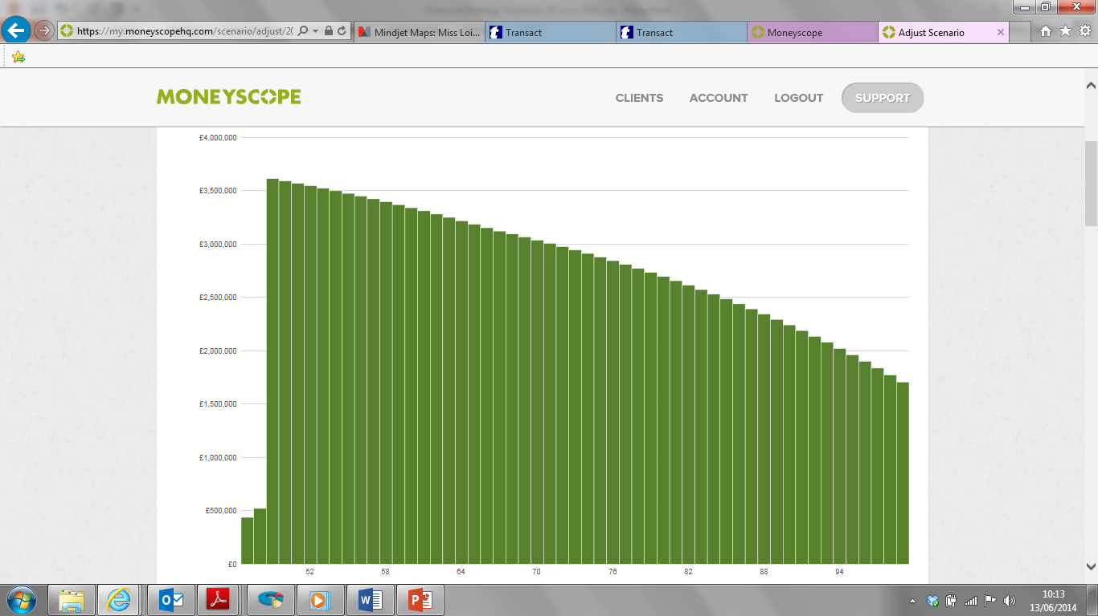
Cash-flow projection 3
Scenario 3: Sale of Company 2015 Buy To Let’s also Sold and a 5% Assumed Net Growth Rate.
Excludes Residential Property
£1,800,000
10

Slide 11
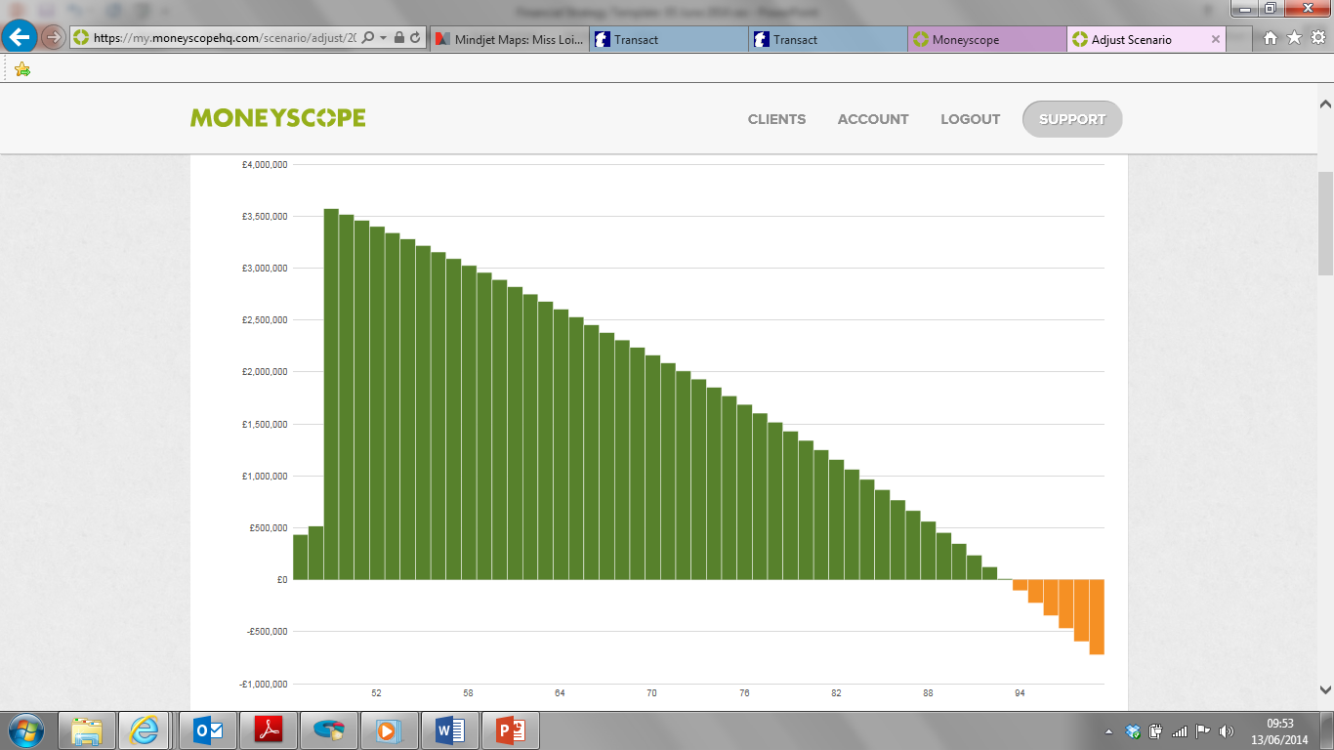
Cash-flow projection 4
Scenario 4: Sale of Company 2015 Buy To Let’s also Sold and a 4% Assumed Net Growth Rate.
Excludes Residential Property
- £625,000
11

Slide 12
What do the cash-flow projections show us?
You can afford to sell the Business next year and you will maintain your financial security.
You will be able to maintain your current, if not enhanced lifestyle, throughout retirement.
You should consider selling your Buy To Let Property Portfolio in order to simplify your investments as well as diversify your holdings which in return will reduce the liquidity risks incumbent in that asset.
This action will also give you the added benefit of access to funds.
Your current mix of investments does increase your risk levels beyond the level of risk you need to take, which in turn exposes you to a higher risk of financial loss that could derail your financial security demonstrated within the “Cash Flows”.
The required investment return to meet your goals is within your recently assessed risk tolerance range, and you should consider adopting a more cautious investment strategy.
All assumptions can not be guaranteed and they are for illustrative purposes only.
12

Slide 13
The Risk Assessment Process
In depth discussion/ resolution
Risk attitude
Risk capacity
Risk need

Slide 14
Your need to take risk
This relates to the returns that you need to achieve to meet your lifestyle goals.
The higher the level of return you need, the more risk you will need to take.
More risk (measured in terms of losses) implies a higher level of ‘growth’ assets.
Risk budgeting needs:
  Cashflow modeling tools to provide insight into what return you need to achieve your goals.
  An understanding that you do not need to take investment risk just because you have a high attitude and capacity for it.
  Returns are never guaranteed and running cash flow scenarios using lower expected returns may be useful.
Your financial need to take risk (i.e. achieve returns)
‘Equity’ assets | 0% | 20% | 40% | 60% | 80% | 100%
Net pa growth assumptions used in cash-flow projections | + 2% | + 3% | + 4% | + 5% | + 6% | + 7%

Slide 15
Your capacity to take risk
You have a unique set of goals.
Your portfolio could suffer losses.
How much can you afford to lose, before you endanger your critical goals?
Gauging risk capacity:
  Modeling worst-case losses provides insight into your financial capacity to survive these periods.
  Longer investment horizons and higher levels of net assets may increase risk capacity.
  The degree of flexibility in your financial plan is important.
Risk capacity – peak-to-trough falls (see note)
Equity assets | 0% | 20% | 40% | 60% | 80% | 100%
Tech wreck* | +11% | +2% | -7% | -15% | -24% | -31%
Credit crisis** | +7% | -4% | -15% | -25% | -35% | -44%
* UK equity market crashes 1-2000 to 1-2003 – UK equity market fell by 46%, ** 11-2007 to 2-2009 – UK equity market fell by 42%. Data illustrates simulated portfolio returns after-inflation but no costs of any kind (e.g. product total expense ratios, rebalancing costs and adviser fees) have been deducted - please read the accompanying notes. Worst-case outcomes in the future may be better or worse than the historical simulations provided.

Slide 16
Your attitude to risk
Every investor has an emotional point beyond which it starts to become too painful to stay invested.
This point is a relatively stable trait irrespective of market conditions.
It can be broadly gauged using an emotional risk profiling questionnaire.
Risk profiling output – emotional attitude to risk
Best fit range | Zero tolerance | Very low | Low | Medium | Quite high | High
Equity assets | 0% | 20% | 40% | 60% | 80% | 100%

Slide 17
Your Risk Profile – resolving trade-offs
Partners/family members may have different risk tolerances.
Your capacity for loss may be higher than your risk tolerance (and vice versa).
Your need to take risk may be higher than your risk tolerance and risk capacity (and vice versa).
Resolving these trade-offs:
  Through informed discussion aided by cash flow scenarios and stress testing.
  By fully understanding the likely characteristics of your portfolio.
Mapping where you are today
Risk Profile score |  | R: Very Low |  | C: Medium
‘Equity’ assets | 0% | 20% | 40% | 60% | 80% | 100%
Risk capacity |  | ~% | ~-35%
Risk need |  |  |  | 5%
Current portfolio |  |  |  |  | 92% equity
Recommended Risk Profile |  |  |  | 60%

Slide 18
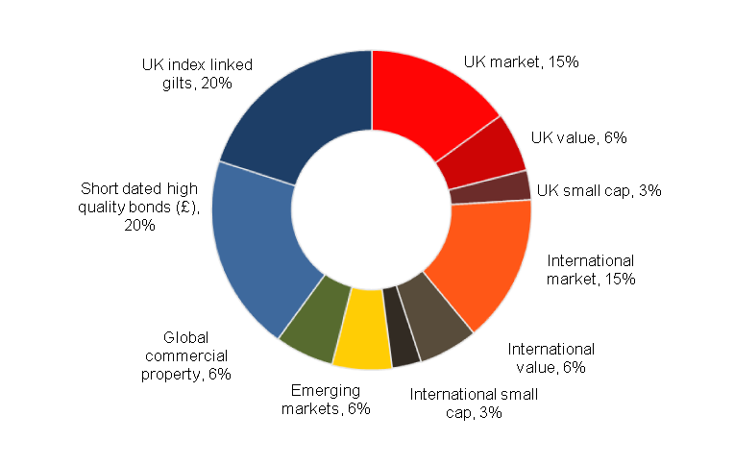
Recommended Asset Allocation
What does this mean in practice?
BALANCED portfolio
(medium risk) =
60% growth / 40% defensive
Anticipate net 5% pa return from
this portfolio mix.
18
Notes:
18

Slide 19
Your current ‘Asset Allocation’
(your existing spread of investments)
It appears your existing overall asset allocation is closest to our ‘Quite High Risk’ portfolio which contains 80% Equity, but this would appear to be significantly outside of your risk comfort range and need boundaries.
The capital is currently invested on a High Risk basis, predominantly Property and Company Shares, which seems to lack any link to your specific goals and objectives, i.e. you are taking a higher risk level than you need to meet your stated goals.
The levels of property you currently carry exposes you to unnecessary liquidity risk.
You may have some issues around Capital Gains Tax on the sale of the properties, however as discussed at our last meeting, with careful planning these liabilities can be reduced considerably.
Individual company shares exposes you to unnecessary diversification risk. You can retain some exposure to equities but through funds, reducing risk substantially.
19

Slide 20
Capital Gains Tax?
Capital Gains Tax Calculation
2014/15 Example of Sale of Properties:
Calculation: £31,100 Gain
- £6,250 Loss
£24,850 Gain.
CGT Allowances 2014/15 £11,000 x 2 - £22,000
£2,850 Gain x 28% = £798 CGT To Pay 14/15
Property | Gain | Loss
10 Rob | £1,000
11 Som |  | £6,250
30 Bide | £30,100
Totals | £31,100 | £6,250
2015/16 Example of Sale of Properties:
Property | Gain | Loss
4 Lea | £25,600 | Nil
Totals | £25,600 | Nil
Calculation: £25,600 Gain
*CGT Allowances 2015/16 £11,000 x 2 - £22,000
£3,600 Gain x 28% = £1,008 CGT To Pay 15/16.
*Assumes no change in Capital Gains Tax Allowances
20

Slide 21
What is the plan?
Recommendation No: 1
Invest £30,000 of the proposed £160,000 of your Low Interest yielding Cash Deposits in the most tax efficient way possible with SIPP Centre:
Chris to utilise
the 2014/15
ISA allowance
of £15,000
Invest in ISA’s
with
Transact
Invest for
Tax Free
Growth & Income
Balanced Strategy
Rose to
utilise
the 2014/15
ISA allowance
of £15,000
Reason Why:
Current Interest rates are low and in some cases not even keeping pace with inflation, by moving funds to a Balanced Investment strategy will give you the potential for greater tax efficient growth and tax efficient income, whilst maintaining access.
The new proposed investments will fit in with your risk tolerance and therefore will now be a consistent part of your overall game-plan.
21
Notes:
21

Slide 22
What is the plan?
Recommendation No: 2
Utilise the balance of your available cash deposits, £130,000, and invest within the SIPP Centre General Investment Account.
Invest Jointly
£130,000
Into the
General Investment
Account
With
Transact
Invest for
Tax Efficient
Growth & Income
Medium investment strategy
*Preliminary Assessment
Reason Why:
This will give you the potential for greater growth and income over the medium to longer term.
The funds selected will match your current Attitude Towards Risk, and can be adapted to suit any future changes or needs.
Although this investment is considered medium to longer term, access to funds will be maintained*.
This investment can be utilised in order to fund future years ISA allowances and therefore increase the tax efficiency of your overall portfolio further.
*We always recommend that separate funds are maintained for emergencies.
22
Notes:
22

Slide 23
What is the plan?
Recommendation No: 3
Utilise the proceeds from the sale of your Buy To Let Property Portfolio, and invest initially within the SIPP Centre General Investment Account and then subscribe to your ISA on an annual basis.
Invest Jointly
BTL Proceeds
Into the
General Investment
Account
With
Transact
Invest for
Tax Efficient
Growth & Income
Utilise
Annual ISA
Allowances
Invest for
Tax Free
Growth & Income
Balanced Strategy
Balanced Strategy
*Preliminary Assessment
Reason Why:
This will give you the potential for greater growth and income over the medium to longer term.
The funds selected will match your current Attitude Towards Risk, and can be adapted to suit any future changes or needs.
Although this investment is considered medium to longer term, access to funds will be maintained*.
This investment can be utilised in order to fund future years ISA allowances and therefore increase the tax efficiency of your overall portfolio further.
*We always recommend that separate funds are maintained for emergencies.
23
Notes:
23

Slide 24
What is the plan?
Recommendation No: 4
Transfer your Individual Cash ISA’s to the SIPP Centre ISA
Cash ISA’s
Invest in the Balanced strategy
Transact ISA for
Tax Efficient
Growth & Income
Reason Why:
This existing ISA’s although free from any visible charges will be earning little interest due to the current Bank Of England Base Rate being so low.
The Cash ISA plans give some balance to your portfolio however they do not match your risk tolerance levels as indicated in the Fina Metrica attitude towards risk exercise carried out as part of this review.
The Transact ISA’s, although subject to charges, will then be following the same investment strategy and form part of the overall game-plan.
There are no penalties so this transfer can take place at any time, and going forward as of July 2014 invested funds can be transferred back to Cash ISA at any time.
24
Notes:
24

Slide 25
Remember our investment process?
The risky approach
Our safer approach
Tactical performance chasing
Strategic risk management
Driven by business model
Driven by evidence
Decisions based on upside
Decisions based on probability
Play on emotions
Constrain emotions
Complex & opaque products
Transparent & simple products
Ad hoc processes
Disciplined processes
Exciting but flawed
Boring but effective
25
Notes:
25

Slide 26
Reminding you:
our approach to investing
Our investment process is a risk-managed, institutional quality buy-hold, rebalance approach that instils discipline to overcome the corrosive nature of emotional decision-making.
It is executed using high quality, low cost funds provided by some of the investment world's pre-eminent fund management firms.
We believe that its offers our clients the best chance of a successful outcome. Belief, discipline and patience are key.

Slide 27
Transparent fees for the value we deliver you
Fees agreed with you are our ONLY source of revenue.
Our fees
Step 1: Discovery Meeting
No charge
Step 2: Strategy Presentation
Step 3: Mutual Commitment
£ fixed fee + VAT
No charge in your case
Step 4: Implementation
One-off
1%
Based on assets moved to our control
(We estimate you will move about £500,000, attracting a £5,000 charge).
1%
p.a.
Ongoing
Step 5: Review
(Relationship Fee)
Minimum Fee of £2,500 pa applies
Based on assets managed by us
(for example if you had £500,000 invested
our annual charge would be £5,000).
Third party costs
Fund total expense ratios
Typically in the region of 0.30% to 0.40% pa
Platform / Product costs
Typically 0.35% pa or less

Slide 28
The Results
Following these recommendations we have:
Redistributed your asset base to allow you more liquidity at less risk
Increased the Tax Efficiency of your portfolio by utilising more tax efficient products and allowances
that are available to you on an annual basis.
Kept your income at a level that will allow you to enjoy your lifestyle for the next 12 months and beyond.
Targeted an IHT free distribution to your heirs
Provide you with confidence that you can meet your goals and make the most of your retirement and not worry
You will also have access to our advanced planning network of carefully selected professionals, that, if required,
provide specialist advice on Tax Mitigation, Wealth Transfer, Wealth Protection and Charitable Giving.
Note: Selling your property may realise a Capital Gains tax event
28
Notes:
28

Slide 29
The plan goes on - what to carry forward?

Slide 30
Risk warnings
  Past performance is no guarantee of future performance.
  The value of investments is not guaranteed and you may not get back the full amount invested.
  All statements concerning the tax treatment of products and their benefits are based on our understanding of current tax law and Her Majesty’s Revenue and Customs (HMRC) practice. Levels and bases of tax relief are subject to change.
  We are authorised and regulated by the Financial Conduct Authority.
30
Notes:
30

